Slide 1
Parallel Computing with GPUs: Warp Level CUDA
Notes:
逻辑上，所有thread是并行的，但是，从硬件的角度来说，实际上并不是所有的thread能够在同一时刻执行，接下来我们将解释有关warp的一些本质。

Slide 2





Thread Block Scheduling
Streaming Multiprocessor 1
Multiple blocks scheduled to Streaming Multiprocessor
Streaming Multiprocessor 2
warp是SM的基本执行单元。一个warp包含32个并行thread，这32个thread执行于SIMT模式。也就是说所有thread执行同一条指令，并且每个thread会使用各自的data执行该指令。

Slide 3


Thread Block Scheduling
Thread Block 0
Thread Block 0, WARP 1
Thread Block 0, WARP 0
block可以是一维二维或者三维的，但是，从硬件角度看，
所有的thread都被组织成一维，每个thread都有个唯一的ID

Slide 4

Warp Scheduling
Streaming Multiprocessor
一个warp中的线程必然在同一个block中，如果block所含线程数目不是warp大小的整数倍，那么多出的那些thread所在的warp中，会剩余一些inactive的thread。
Shared Memory / Cache
Scheduler / Dispatcher
Instruction Cache and Registers
Notes:
Zero overhead to swap warps (warp scheduling)
Warps contain only threads from a single
thread block
Warps can be swapped with warps from different blocks assigned to the same streaming multi processor
At any one time only one warp has operations being executed
Memory movement happens in background
也就是说，即使凑不够warp整数倍的thread，硬件也会为warp凑足，只不过那些thread是inactive状态，需要注意的是，即使这部分thread是inactive的，也会消耗SM资源。

Slide 5
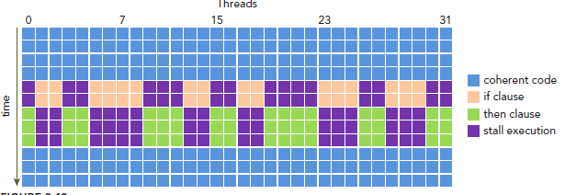
Warps and SIMD
SIMD
Instruction Pool
GPU支持传统的控制流语句；
CPU有复杂的硬件设计可以很好的做分支预测；
GPU就没那么复杂的分支预测了
warp divergence问题只会发生在同一个warp中。
为了获得最好的性能，就需要避免同一个warp存在不同的执行路径。
Data Pool
PU
Vector Unit
PU
PU
PU
Notes:
Execution of GPU instructions is always in groups of threads called
warps
Within a warp execution on the hardware follows the SIMD execution model
The view outside of a warp is SIMT
What happens if code within a warp has different control flow?
这样我们的问题就来了，因为所有同一个warp中的thread必须执行相同的指令，那么如果这些线程在遇到控制流语句时，如果进入不同的分支，那么同一时刻除了正在执行的分之外，其余分支都被阻塞了，十分影响性能。这类问题就是warp divergence。

Slide 6

Coherent Code
global void a_kernel()
{
if (blockIdx.x % 2)
//something
else
//something else
}
global void b_kernel()
{
if (threadIdx.x % 2)
//something
else
//something else
}
Which is coherent?
Which is divergent?

Slide 7

Divergence Example
global void a_kernel()
{
if (threadIdx.x % 2)
//something
else
//something else
}
All warps
Branch (divergence)
if (threadIdx.x % 2)
else
End of Branch (convergence)

Slide 8
Divergence Example Alternative
global void a_kernel()
{
if (blockIdx.x % 2)
//something
else
//something else
}
Warp 0
Branch
if (blockIdx.x % 2)
End of Branch

Slide 9
Divergence Example Alternative
global void a_kernel()
{
if (blockIdx.x % 2)
//something
else
//something else
}
Warp 1 (assuming thread block size of 32)
Branch
else
End of Branch

Slide 10
Levels of divergence
global void a_kernel(int *a)
{
int a = a[threadIdx.x + blockIdx.x*blockDim.x] if (a==0)
//code for case 0
else if (a==1)
//code for case 1
else if (a==2)
//code for case 2 else if (a==3)
//code for case 3
}
global void a_kernel(int *a)
{
int a = a[threadIdx.x + blockIdx.x*blockDim.x] switch (a){
case(0):
//code for case 0 with break case(1):
//code for case 1 with break
case(2)
//code for case 2 with break
case(3)
//code for case 3 with break
}
}
Notes:
Divergent code can be classified by how many “ways” it diverges.
E.g. the following examples are 4-way divergent (and functionally equivalent)
If a warp has 32-way divergence this will have a massive impact on performance!

Slide 11


2D blocks and divergence
global void a_kernel()
{
if (threadIdx.y % 2)
//something
else
//something else
}
Thread Block 0
global void b_kernel()
{
if (threadIdx.y / 4)
//something else
//something else
}
How many ways of divergence?

Slide 12

2D blocks and divergence
global void a_kernel()
{
if (threadIdx.y % 2)
//something
else
//something else
}
Thread Block 0 – showing threadIdx.y
2
3 | 3 | 3 | 3 | 3 | 3 | 3 | 3
2 | 2 | 2 | 2 | 2 | 2 | 2 | 2
1 | 1 | 1 | 1 | 1 | 1 | 1 | 1
0 | 0 | 0 | 0 | 0 | 0 | 0 | 0
WARP 0
global void b_kernel()
{
if (threadIdx.y / 4)
//something else
//something else
}
0
How many ways of divergence?

Slide 13
What is wrong with the following
global void max_kernel(int *a)
{
shared int max;
int my_local = a[threadIdx.x + blockIdx.x*blockDim.x];
if (my_local > max)
max = my_local;
}

Slide 14
CUDA也存在互斥访问的问题：
global void max_kernel(int *a)
{
shared int max;
int my_local = a[threadIdx.x + blockIdx.x*blockDim.x];
if (my_local > max)
max = my_local;
}
Notes:
当一个线程改变变量,而另外一个线程在读取变量的值，执行原子操作类似于有一个自旋锁，只有等Ｘ的变量在改变完成之后，才能执行读操作，这样可以保证每一次读取的都是最新的值.

Slide 15
原子操作（Atomics）
global void max_kernel(int *a)
{
shared int max;
int my_local = a[threadIdx.x + blockIdx.x*blockDim.x];
if (my_local > max)
max = atomicMax(&max, my_local);
}
执行原子操作类似于有一个自旋锁，只有等变量在改变完成之后，才能执行读操作，这样可以保证每一次读取的都是最新的值.

Slide 16
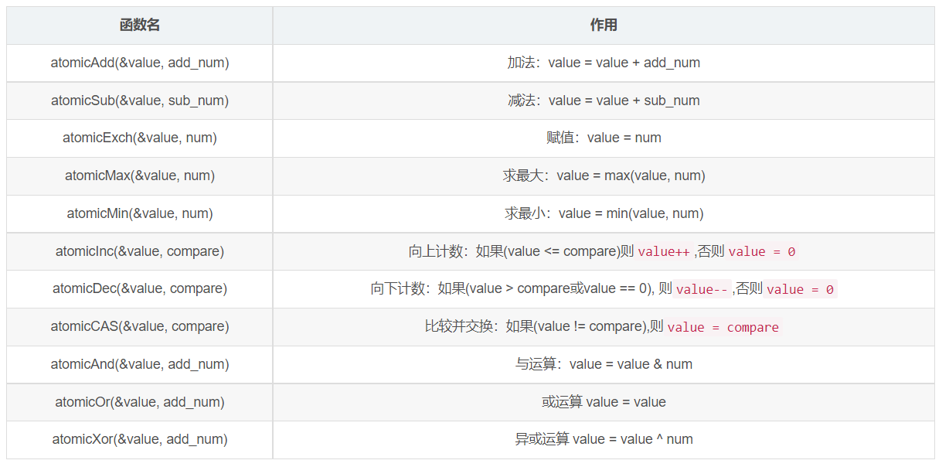
原子操作（Atomics）
Programming Guide :: CUDA Toolkit Documentation (nvidia.com)

Slide 17
统计“char data_0[32] = {1,0, … ,1}”这个数组中“0”和“1”的个数并写入“int counter[2]”中
extern "C" __global__ void kernel_func(int * counter, char * data_0)
{
// 计算线程号
unsigned int index = threadIdx.x + blockDim.x * blockIdx.x;
// 统计结果
int value = data_0[index];
counter[value] ++;
}
counter[2] = {1, 1}

Slide 18
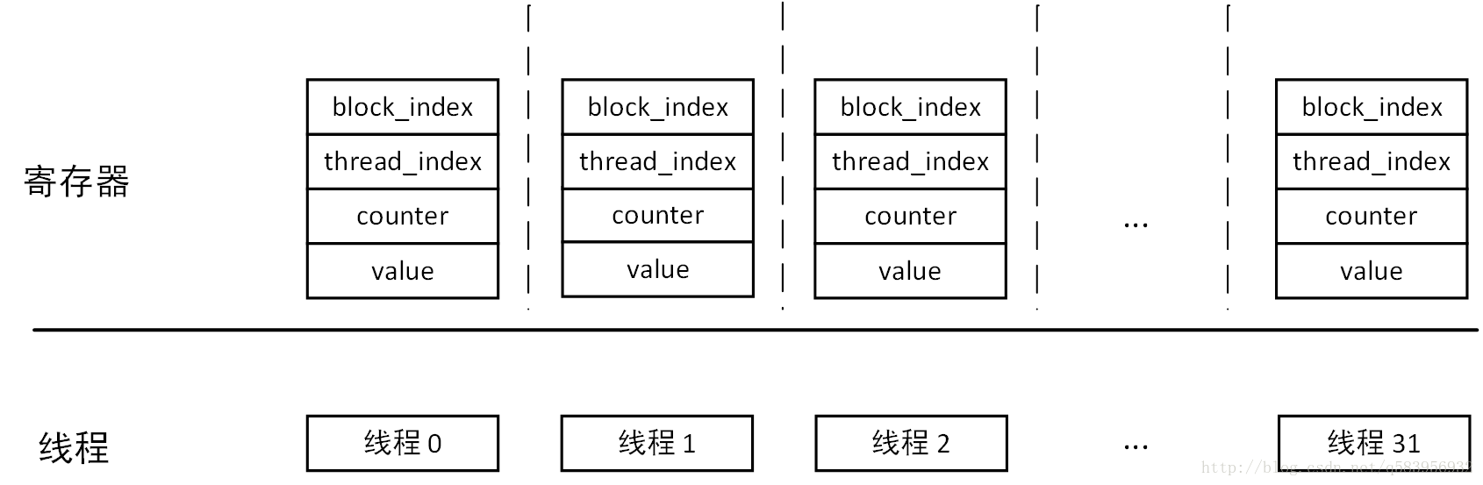
Notes:
在GPU中，线程在并行时，每个线程（Thread）都会有一组专供自己的用的寄存器。例如上面的代码中，我们在核函数中定义了“block_index”、“thread_index”、“value”三个寄存器，此外编译器还会自动生成一个“counter”寄存器。也就是说，当这32个线程（Thread）并行执行的时候，会占用个32位寄存器。

Slide 19
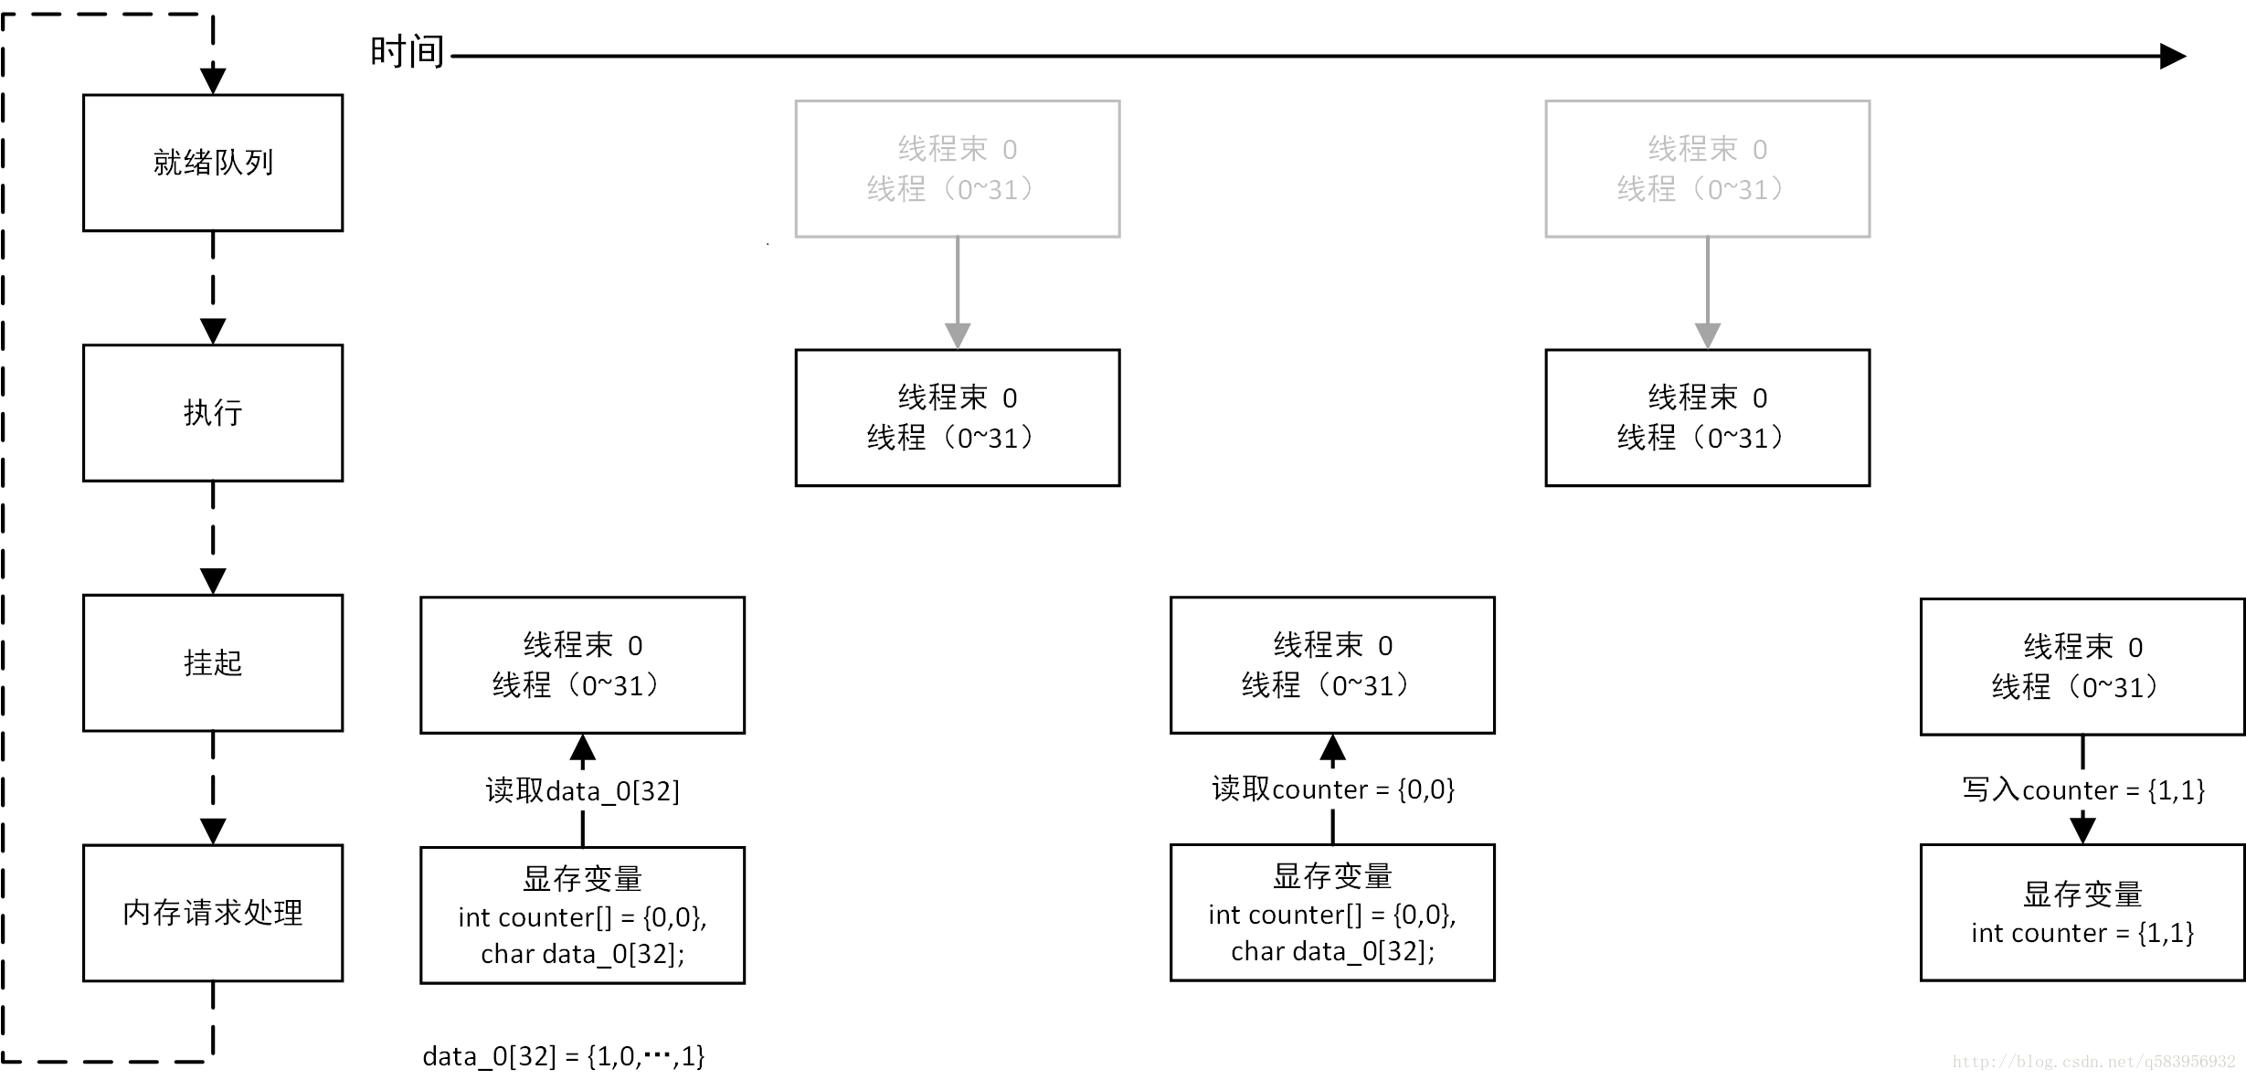
Notes:
线程束0（即线程0到31），从全局显存中读取了数组“data_0”的数值放在每个线程对应的寄存器“value”中。
线程0到31几乎同时分别占用一个SP，然后第ii条线程根据各自的寄存器“value”中的数值，准备读取显存变量“counter[value]”的值。（此时“counter[2] = {0, 0}”）
线程束0读取显存变量“counter[value]”到各个线程的寄存器“counter”中。
线程0到31同时对自己的“value”寄存器中的数值执行“++”。
线程束0将寄存器“counter”值写入显存变量“counter[value]”中。（此时“counter[2] = {1, 1}”）

Slide 20
统计“char data_0[32] = {1,0, … ,1}”这个数组中“0”和“1”的个数并写入“int counter[2]”中
extern "C" __global__ void kernel_func(int * counter, char * data_0)
{
// 计算线程号
unsigned int index = threadIdx.x + blockDim.x * blockIdx.x;
// 统计结果
int value = data_0[index];
//counter[value] ++;
atomicAdd(&counter[value], 1);
}
counter[2] = {1, 1}

Slide 21
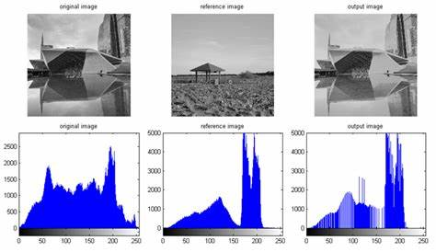
Histogramming
在统计学中，直方图（英语：Histogram）是一种对数据分布情况的图形表示，是一种二维统计图表，它的两个坐标分别是统计样本和该样本对应的某个属性的度量。
图像直方图（英语：Image Histogram）是用以表示数字图像中亮度分布的直方图，标绘了图像中每个亮度值的像素数。可以借助观察该直方图了解需要如何调整亮度分布。这种直方图中，横坐标的左侧为纯黑、较暗的区域，而右侧为较亮、纯白的区域。因此，一张较暗图片的图像直方图中的数据多集中于左侧和中间部分；而整体明亮、只有少量阴影的图像则相反。

Slide 22
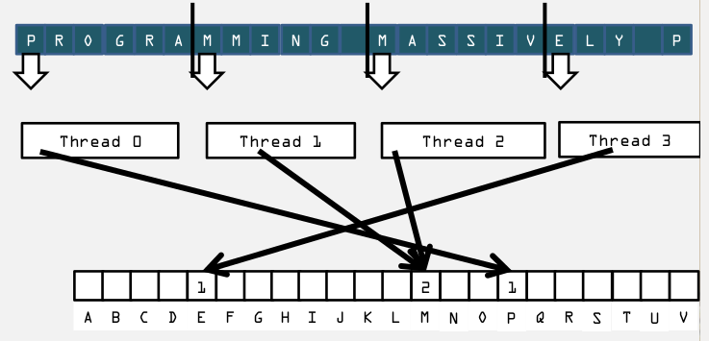
Histogramming
比如一个句子"Programming Massively Parallel Processors",我们构建一个字母出现频率的直方图.
A(4次), C(1), E(1), G(1), ...
Host端我们做统计的话,就会构建26大小的数组来表示a-z,然后遍历这个句子,碰到不同的case进行累加操作.
Device端并行化: 把这个sentense 划分成多个block,每个block统计自己的情况,同意保存到一个数组里面.

Slide 23
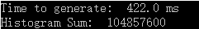
CPU
#define SIZE (100*1024*1024)
int main(void) {
unsigned char *buffer =
(unsigned char*)big_random_block(SIZE);
clock_t start, stop; start = clock();
unsigned int histo[256];
for (int i = 0; i<256; i++)
histo[i] = 0;
for (int i = 0; i < SIZE; i++)
histo[buffer[i]]++; stop = clock();
float elapsedTime = (float)(stop - start) /
(float)CLOCKS_PER_SEC * 1000.0f;
printf("Time to generate: %3.1f ms\n", elapsedTime);
long histoCount = 0;
for (int i = 0; i<256; i++) { histoCount += histo[i]; }
printf("Histogram Sum: %ld\n", histoCount);
free(buffer); return 0;
}

Slide 24
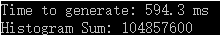
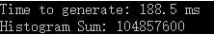
GPU 原子操作
GPU 原子操作+动态内存
__global__ void histo_kernel(unsigned char *buffer, long size, unsigned int *histo){
__shared__ unsigned int temp[256];
temp[threadIdx.x] = 0;
__syncthreads();
int i = threadIdx.x + blockIdx.x * blockDim.x;
int offset = blockDim.x *gridDim.x;
while (i<size){
atomicAdd(&temp[buffer[i]], 1);
i += offset;
}
__syncthreads();
atomicAdd(&(histo[threadIdx.x]), temp[threadIdx.x]);
}
__global__ void histo_kernel(unsigned char *buffer, long size, unsigned int *histo){
int i = threadIdx.x + blockIdx.x * blockDim.x;
int stride = blockDim.x * gridDim.x;
while (i < size){
atomicAdd(&histo[buffer[i]], 1);
i += stride;
}
}

Slide 25





Slide 26
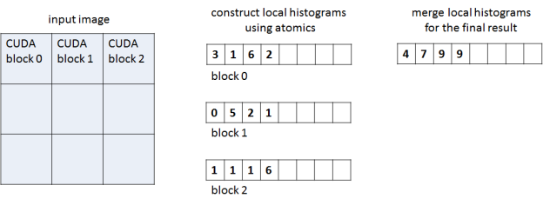
The two-phase parallel histogram algorithm.
Notes:
In the first phase each CUDA thread block processes a region of the image and accumulates a corresponding local histogram, storing the local histogram in global memory at the end of the phase. The second kernel accumulates all per-block histograms into the final histogram stored in global memory. The work separation between blocks in the first phase reduces contention when accumulating values into the same bin.

Slide 27
global atomics
__global__ void histogram_gmem_atomics(const IN_TYPE *in, int width, int height, unsigned int *out)
{
// pixel coordinates
int x = blockIdx.x * blockDim.x + threadIdx.x;
int y = blockIdx.y * blockDim.y + threadIdx.y;
// grid dimensions
int nx = blockDim.x * gridDim.x;
int ny = blockDim.y * gridDim.y;
// linear thread index within 2D block
int t = threadIdx.x + threadIdx.y * blockDim.x;
// total threads in 2D block
int nt = blockDim.x * blockDim.y;
// linear block index within 2D grid
int g = blockIdx.x + blockIdx.y * gridDim.x;
// initialize temporary accumulation array in global memory
unsigned int *gmem = out + g * NUM_PARTS;
for (int i = t; i < 3 * NUM_BINS; i += nt) gmem[i] = 0;
// process pixels
// updates our block's partial histogram in global memory
for (int col = x; col < width; col += nx)
for (int row = y; row < height; row += ny) {
unsigned int r = (unsigned int)(256 * in[row * width + col].x);
unsigned int g = (unsigned int)(256 * in[row * width + col].y);
unsigned int b = (unsigned int)(256 * in[row * width + col].z);
atomicAdd(&gmem[NUM_BINS * 0 + r], 1);
atomicAdd(&gmem[NUM_BINS * 1 + g], 1);
atomicAdd(&gmem[NUM_BINS * 2 + b], 1);
}
}

Slide 28
shared atomics
// initialize temporary accumulation array in shared memory
__shared__ unsigned int smem[3 * NUM_BINS + 3];
for (int i = t; i < 3 * NUM_BINS + 3; i += nt) smem[i] = 0;
__syncthreads();
// process pixels
// updates our block's partial histogram in shared memory
for (int col = x; col < width; col += nx)
for (int row = y; row < height; row += ny) {
unsigned int r = (unsigned int)(256 * in[row * width + col].x);
unsigned int g = (unsigned int)(256 * in[row * width + col].y);
unsigned int b = (unsigned int)(256 * in[row * width + col].z);
atomicAdd(&smem[NUM_BINS * 0 + r + 0], 1);
atomicAdd(&smem[NUM_BINS * 1 + g + 1], 1);
atomicAdd(&smem[NUM_BINS * 2 + b + 2], 1);
}
__syncthreads();
// write partial histogram into the global memory
out += g * NUM_PARTS;
for (int i = t; i < NUM_BINS; i += nt) {
out[i + NUM_BINS * 0] = smem[i + NUM_BINS * 0];
out[i + NUM_BINS * 1] = smem[i + NUM_BINS * 1 + 1];
out[i + NUM_BINS * 2] = smem[i + NUM_BINS * 2 + 2];
}
}
__global__ void histogram_smem_atomics(const IN_TYPE *in, int width, int height, unsigned int *out)
{
// pixel coordinates
int x = blockIdx.x * blockDim.x + threadIdx.x;
int y = blockIdx.y * blockDim.y + threadIdx.y;
// grid dimensions
int nx = blockDim.x * gridDim.x;
int ny = blockDim.y * gridDim.y;
// linear thread index within 2D block
int t = threadIdx.x + threadIdx.y * blockDim.x;
// total threads in 2D block
int nt = blockDim.x * blockDim.y;
// linear block index within 2D grid
int g = blockIdx.x + blockIdx.y * gridDim.x;

Slide 29
second kernel： we accumulate all partial histograms into the global one
__global__ void histogram_final_accum(const unsigned int *in, int n, unsigned int *out)
{
int i = blockIdx.x * blockDim.x + threadIdx.x;
if (i < 3 * NUM_BINS) {
unsigned int total = 0;
for (int j = 0; j < n; j++)
total += in[i + NUM_PARTS * j];
out[i] = total;
}
}

Slide 30
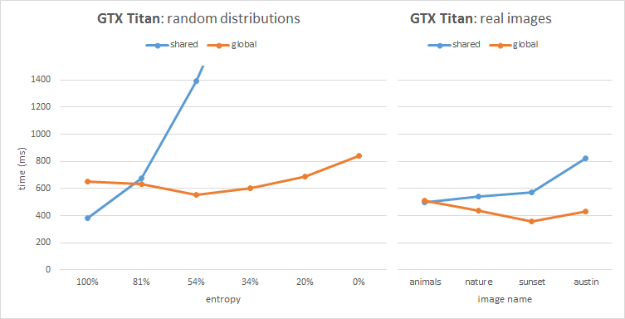
Performance of our histogram algorithm comparing global memory atomics to shared memory atomics on a Kepler architecture NVIDIA GeForce GTX TITAN GPU.

Slide 31
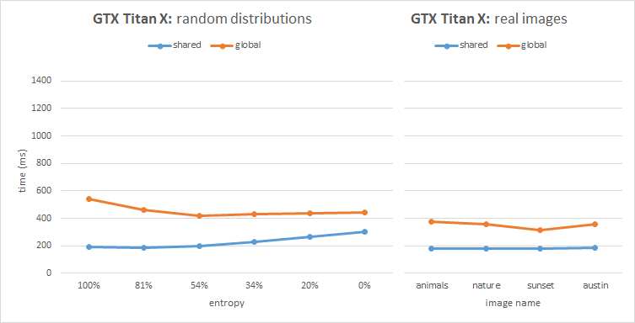
Performance of our histogram algorithm comparing global memory atomics to shared memory atomics on a Maxwell architecture NVIDIA GeForce GTX TITAN X GPU.

